Slide 1
SATELLITES
Ms. Greco and Grossi
Grade 6 Space

Slide 2
What is a Satellite???
A satellite is any object that orbits or revolves around another object. For example, the Moon is a satellite of Earth, and Earth is a satellite of the Sun.
Today we will be examining 5 different types of satellites

Slide 3
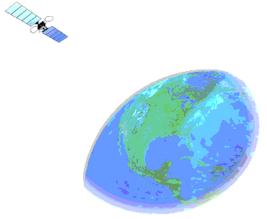
1) Communication Satellites
Relay Stations
Communications satellites act as relay stations in space. People use them to bounce messages from one part of the world to another. These messages can be telephone calls, TV pictures, or even Internet connections like the one you're using now
Communications satellites like EchoStar are in geosynchronous orbit (from geo = Earth + synchronous = moving at the same rate). That means that the satellite always stays over one spot on Earth. The area on Earth that it can "see" is called the satellite's "footprint." Here is one footprint that covers all of Africa. A person in Africa can use this satellite to communicate with anyone else in Africa.

Slide 4
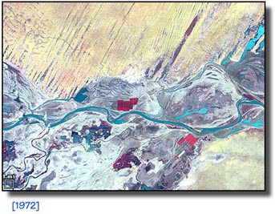
2) Earth Remote Sensing
Remote-sensing satellites, like the one shown on the left, study Earth's surface. From 300 miles (480 km) up, this satellite uses powerful cameras to scan the planet. The satellite then sends back valuable data about global environments.
The instruments on remote-sensing satellites study Earth's plant cover, chemical composition, and surface water, among many other features. People who work in farming, fishing, mining, and many other industries find this information very useful.
We can also use remote sensing satellites to study changes in the earth's surface that are caused by people. Examples of this include the parts of West Africa that are turning into desert (desertification), and the destruction of the rainforest in South America (deforestation).

Slide 5
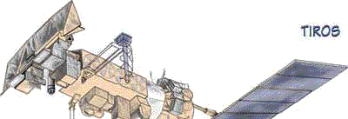
3) Weather
This satellite is called TIROS (Television Infrared Observational Satellite). It records weather patterns around the world. Many countries use TIROS data to forecast weather, track storms, and do scientific research.
TIROS is part of a system of weather satellites operated by the National Oceanic and Atmospheric Administration (NOAA). There are two TIROS satellites circling Earth over the poles. They work with another set of satellites in geosynchronous orbit called Geostationary Operational Environmental Satellites (GOES). Using this group of satellites, meteorologists study weather and climate patterns around the world

Slide 6
4) GPS
This satellite is part of a group of satellites that can tell you your exact latitude, longitude, and altitude. The military developed the Global Positioning System (GPS), but now people everywhere can use these satellites to determine where in the world they are.
GPS satellites are used for navigation almost everywhere on Earth -- in an airplane, boat, or car, on foot, in a remote wilderness, or in a big city. Wherever you are, if you have a GPS receiver, you'll never be lost again!

Slide 7
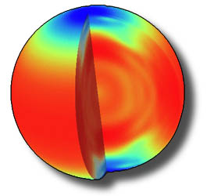
5) Science Research Satellites
Many satellites in orbit conduct scientific experiments and observations. This is SOHO (SOlar and Heliospheric Observation). It's studying the Sun.
SOHO is an international project managed by Europe and the United States. Its very sophisticated instruments can measure activity inside the Sun, look at its atmosphere or corona, and study its surface.

